Slide 1
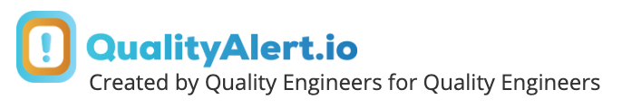
Quality Alert
QualityAlert.io REV A
Controlled Document #: XXXXXXX
Part Number |  | Rev |  | Description |  | Reoccurring Issue?
Supplier Part Number |  | Rev |  | Description |  | Manufacturing Plants
Supplier |  |  |  | Lot Size |  | Tracking# (CAPA)
Defect Lot/Serial Number |  |  |  | Defects |  | Date Concern Found
Location of Finding |  |  |  | Similar Products/Stations Affected
Defect Codes
Photo Area
(Optional)
Box or Physical Part Certification Here
Defect/NOK Image Here
Conforming/OK Image Here
Concern Description
Immediate Action/Fast Response |  | QA# |  | Date Posted
Rework Details |  | Alert Owner |  | Expiration

Slide 2
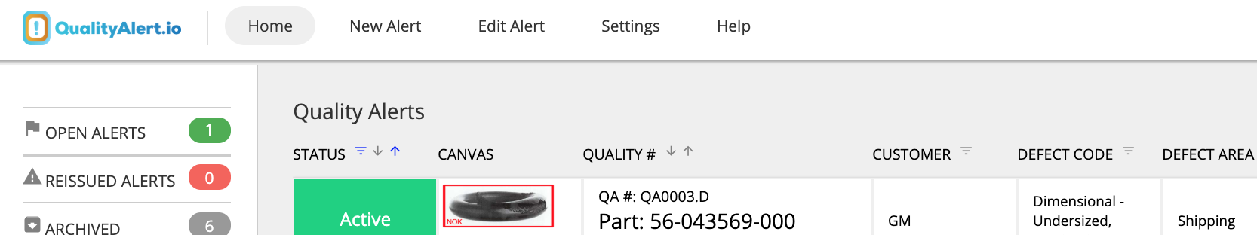
Hey Before You Delete This Page!
I was in your shoes before!
I was a Quality engineer, then Supplier Quality engineer. Doing Quality Alerts
were always so powerful, but took an hour plus of my time and were frustrating.
I knew there had to be a better way. I searched all over the internet,
but couldn’t find it, so I created it.
Create Quality Alerts in under FIVE minutes.
Central Database to Track all Alerts (I’ve tried to track Quality Alerts as Excel files, it doesn't work.)
Run metrics/KPI’s for your alerts
Easy & Intuitive Picture Editing
Automatically have alerts expire. - No need to remember to pull them from the floor.
  I’ve been dinged on a ISO audit for this! Don’t let it happen to you.
Digital TV Board of all Alerts
Easy repost of alerts. (ONE minute, really)
Let me help make your life easier and make your manager happy. Contact me to see if QualityAlert.io your your solution.
Always happy to provide free advice on your Quality System and Problem Solve together. I have a lot of lessons learned that I’m happy to share.
Josh
Founder & CEO of QualityAlert.io - I Love & Live Manufacturing Everyday!
Call or Text: 1 (408) 548-7443
Email: Hello@QualityAlert.io

Slide 3
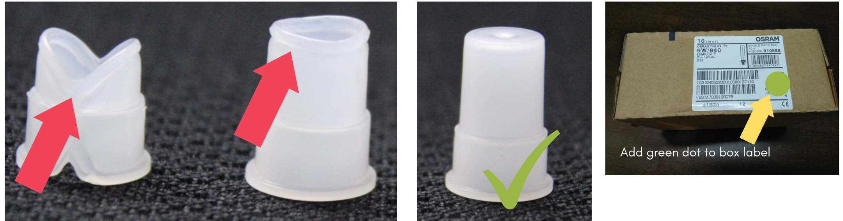
Quality Alert
Replace QualityAlert.io Logo with Your Company Logo
QualityAlert.io REV A
Controlled Document #: 345.TU
Part Number | 8765A | Rev | C | Description | Dust Cap, Clear | Reoccurring Issue? | YES
Supplier Part Number | W.P9882.2 | Rev | 2 | Description | Dust Cap, Clear | Manufacturing Plants | Lordstown
Supplier | Best Injection - OH |  |  | Lot Size | 10,000 | Tracking# (CAPA) | 3443
Defect Lot/Serial Number | 376943050090990 |  |  | Defects | 20 / .2% | Date Concern Found | 1/5/19
Location of Finding | Customer |  |  | Similar Products/Stations Affected | Work Stations #80-90, Shipping
Defect Codes | Short Shot, Start-up, Supplier, Dust Cap
Concern Description | GM reported finding 20 short shots on 1/5/19 & requested 100% certification.
Immediate Action/Fast Response | Contain All In-House Product, 100% Certify next three shipments. | QA# | QA.2019.13 | Date Posted | 1/5/19
Rework Details | 100% Sort & Add Green Dot to All Boxes After Sort | Alert Owner | A.2019.13 | Expiration | 2/5/19 (30 Days)

